Slide 1
Day 3 - jQuery
Authored by : Pooja Jain Presented by : Pooja Jain

Slide 2
Course Structure
Target audience | Fresher
Level | 1
Pre-requisites | HTML, CSS and Javascript
Training methods | PPT and Programs
Evaluation | Assignments provided

Slide 3
Document History
Version No. | Authored/ Modified by | Remarks/ Change History | Date <dd- mon-yy >
1.0 | Pooja Jain |  | 20-09-2016

Slide 4
Quick Recap
What are the different selectors?
ID
Name
Tag
Class
How to use a context?
find vs children
How to change things up?
HTML
Input values
Attributes
CSS
How to add/remove elements from the DOM?

Slide 5
Performance of jQuery lookups
Let’s check :
0 – Lookup.html
1 – Lookup.html
2 – Lookup.html
3 – Lookup.html
And now let’s check the performance of few jQuery lookups in
perf.html

Slide 6
Careful with jQuery lookups
jQuery lookups aren’t magic. It uses native browser lookups where it can.
And when it can’t … it iterates over each and every DOM element based on your context.
.getElementbyID() and .getElementsByName() operate on the document object whereas .getElementsByTagName() and .getElementsByClassName() can be used by any DOM object.
So leverage the tag name lookup with jQuery’s .find() and .children() where appropriate.

Slide 7
Check if jQuery is available on a page
if (!window.jQuery) {
console.log('jQuery is unavailable!');
}
else {
console.log('jQuery is available');
}

Slide 8
Check if element is present on a page
var jqelement = $(“#mydiv”);
if (jqelement.length) {
console.log(‘Element exists!’);
}

Slide 9
Go from jQuery object to DOM object, and back
var jqdiv = $(“#mydiv”);
.
.
var div = jqdiv.get(0);
var div = document.getElementById(“mydiv”);
.
.
var jqdiv = $(div);

Slide 10
Attributes - .attr() vs .prop() vs .data()
$(‘myinput’).attr(‘title’);
$(‘myinput’).prop(‘disabled’);
$(‘myinput’).data(‘previousvalue’);
$(‘myinput’).attr(‘title’, ‘Enter a number’);
$(‘myinput’).prop(‘disabled’, true);
$(‘myinput’).data(‘previousvalue’, ‘123’);
Refer attr_prop_data.html

Slide 11
Events - .on() and .trigger()
$( "#dataTable tbody tr" ).on( "click", function() {
console.log(‘Click triggered on row’);
});
$(“tr”).trigger(‘click’);
Refer event1.html

Slide 12
.load() vs .ready()
$(document).ready(function() {
// Do something once the DOM is ready.
});
$(window).load(function() {
// Do something … only after images, subframes etc. are loaded.
});
Refer event2.html

Slide 13
AJAX - .ajax()
AJAX allows web pages to be updated asynchronously by exchanging small amounts of data with the server behind the scenes.
This means that it is possible to update parts of a web page, without reloading the whole page.

Slide 14
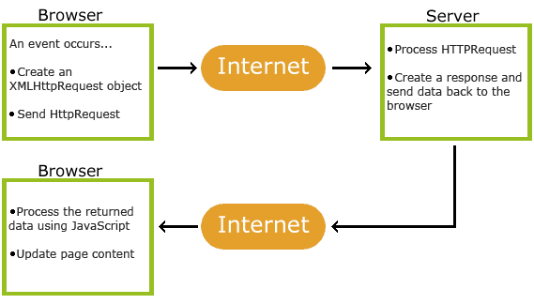
AJAX - .ajax()
Refer ajax.html and serverconf.js

Slide 15
Bibliography, Important Links
jQuery API – All the jQuery documentation you would ever need - https://api.jquery.com/
jQuery CDN – A place to pull various jQuery versions from - http://code.jquery.com/
https://coderwall.com/p/t_cgwq/when-is-better-to-use-data-or-attr

Slide 16
Any Questions?

Slide 17
Thank You!

